Slide 1
Web Programming
MOD002619
Week 5
Django Statics etc.

Slide 2
Session content
Recap
Finishing up the admin pages
Adding Images
Adding static content
Bootstrap
Pagination

Slide 3
5.1 Recap
Web Programming
Week 5 Part 5.1

Slide 4
Recap
Virtual Environment – restart with
  Windows
    .\venv\Scripts\activate.bat
  Linux
    source ./venv/bin/activate
Simply site started with
  python manage.py runserver
    http://127.0.0.1:8000/ - just a welcome page – with a long list of students
    http://127.0.0.1:8000/admin - The admin site, not very user friendly

Slide 5
5.2 Adding Images
Web Programming
Week 5 Part 5.2

Slide 6
Modify the Student Model
Firstly, add a method to the Student model – this will give a nicer output to the Admin pages student list.
def __str__(self):
return self.firstName.capitalize() + ", " + self.lastName.upper()
Add an attribute to store an image of a student
image = models.ImageField(upload_to='images/', blank = True)
This is simple ImageField. The upload to folder is where images will be stored when added through the admin app. Note just files name stored in the db not an image.

Slide 7
Other changes
You will see the following error:
  So, complete the pip install of Pillow.
  Pillow is the friendly PIL fork by Alex Clark and Contributors. PIL is the Python Imaging Library by Fredrik Lundh and Contributors.
As you have added a new attribute to your student model:
  python manage.py makemigrations
  python manage.py migrate

Slide 8
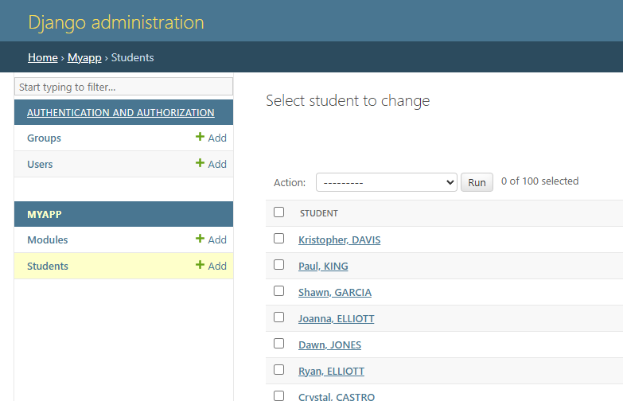
Modified Admin Page
The student list in the admin page now uses our __str__ method to display the object instances.

Slide 9
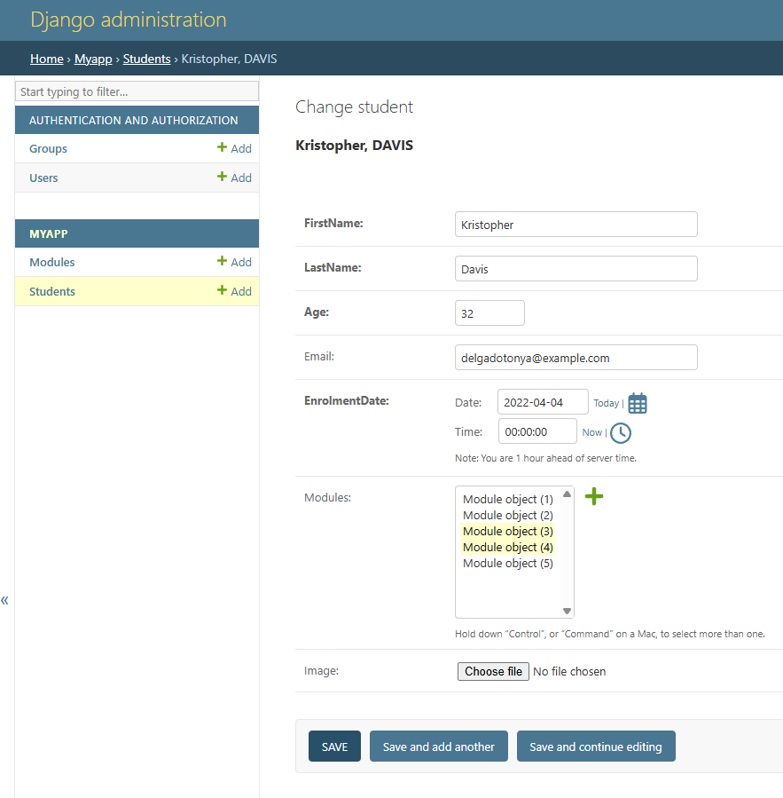
Modified Student Admin Page
We now have the ability to select an image file. The file name will be stored in the database and the file itself will be saved in the specified images folder. This folder will be created automatically.

Slide 10
Using Image Files
First, we need to add media root to the settings.py file:
MEDIA_URL = ‘/media/'
MEDIA_ROOT = BASE_DIR
Then add an additional path to the urls.py file:
from django.conf import settings
from django.conf.urls.static import static
urlpatterns += static(settings.MEDIA_URL,
document_root = settings.MEDIA_ROOT)

Slide 11
Using media files in templates
For further details on media files see the Django documentation
We can now simply add the images into our templates using the image.url attribute e.g.:
<!-- Note checking if image exists first -->
{% if student.image %}
<img src="{{ student.image.url }}"></img>
{% endif %}

Slide 12
5.3 Static files
Web Programming
Week 5 Part 5.3

Slide 13
Static Files
Any website will require several static files as opposed to the dynamic ones we have already considered. These could be logos, general images or framework files.
Django has a mechanism for handling static content as apposed to the dynamic content loaded from the database
Each app has it’s own static directory into which static files are saved.
The project has it’s own static directory into which ALL static content is loaded
A python management script is used to perform this task.
See the Django documentation for further details.

Slide 14
Procedure
Ensure that django.contrib.staticfiles is included in your INSTALLED_APPS.
The settings file should also define STATIC_URL e.g.
STATIC_URL = "static/“
Each app should have a directory called ‘static’ in which you store the static files for that app e.g. myApp/static/myApp/file1.jpg
You can also set static files in other directories that are not tied to a specific app by defining paths in the settings.py file e.g.
STATICFILES_DIRS = [
BASE_DIR / “mystaticfiles",
"/var/www/static/",
]
You need to set the STATIC_ROOT directory in the settings.py file e.g.:
STATIC_ROOT = BASE_DIR / "staticfiles“
Then running “python manage.py collectstatic” will copy all files from your static folders into the STATIC_ROOT directory.

Slide 15
Using Statics in a Template
{% load static %}
<img src="{% static 'myApp/aru.jpg' %}" alt=“ARU">

Slide 16
5.4 Bootstrap
Web Programming
Week 5 Part 5.4

Slide 17
Bootstrap
Bootstrap is a popular frontend toolkit that enables developers to create responsive web sites very quickly
  Mobile first
  Plenty of pre-designed UI components ready to use
  Bootstrap theme and customization lets you easily change styles.
  It is free to use ☺

Slide 18
Installing Bootstrap
Can use online precompiled CSS and JavaScript files via jsdeliver
  See bootstrap quick start for examples
Download compiled CSS and JavaScript from here
  Add the two folders ‘css’ and ‘js’ to your static files as before
  Then just include into your html as you would with other static files

Slide 19
Bootstrap Examples
There are a vast collection of example templates for you to use either view them or download the source here
  Simply find examples you like and then mix and match the components to build your web site.
  For the University Example I have used:
    A simple nav bar
    A centered hero
    A table with striped rows and hoverable rows.

Slide 20
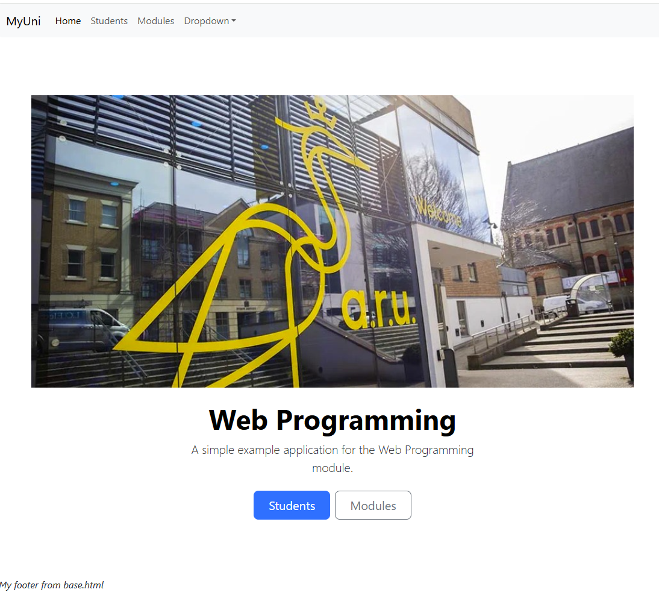
Home Page

Slide 21
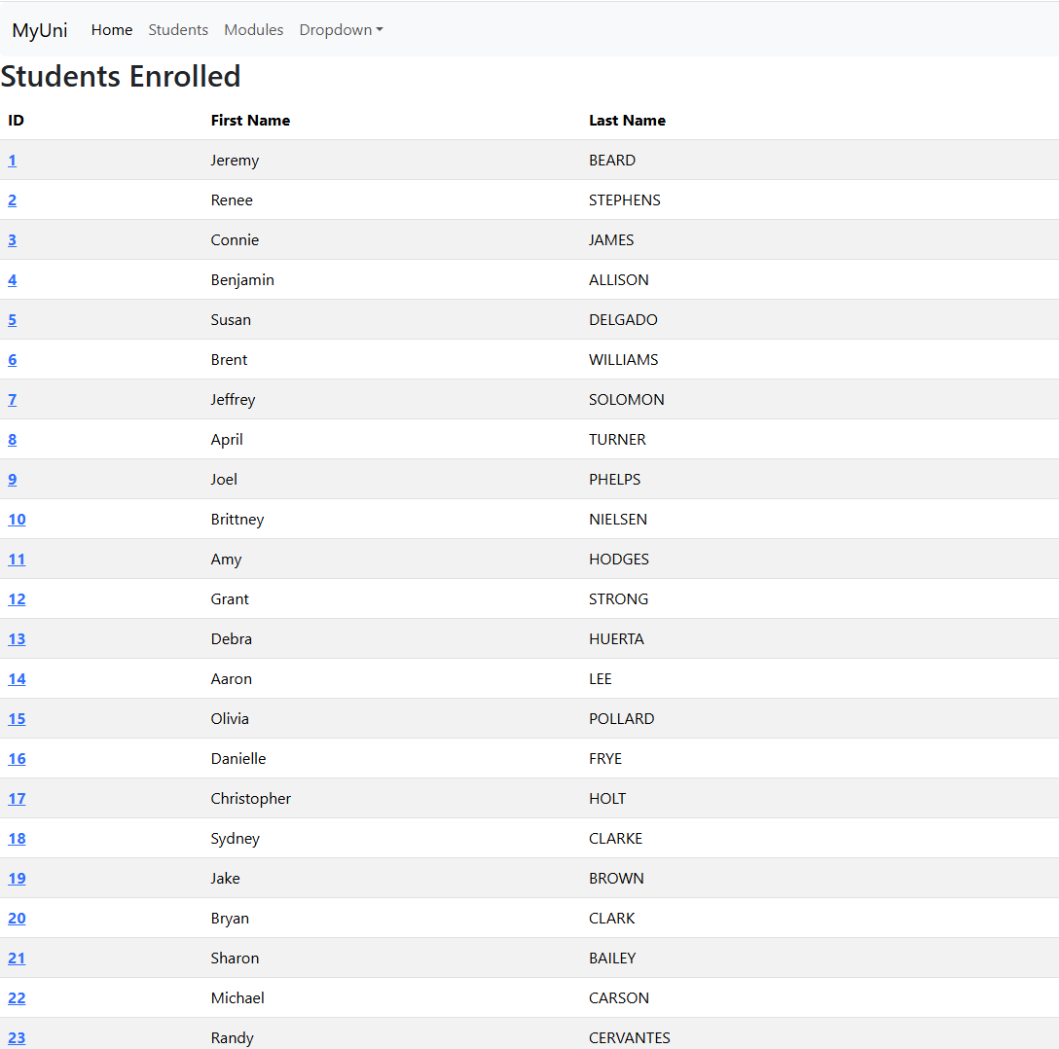
Student List

Slide 22
5.5 Pagination
Web Programming
Week 5 Part 5.3

Slide 23
Pagination
At the moment our application presents the user with a long list of 1000 students. This is not ideal; we would like to present the user with a reasonable size list of students that would fit on one page and then be able to scroll through these pages.
Django provides a Paginator class and associated Page class for just this.

Slide 24
Paginator Constructor
Paginator(
object_list, per_page,
orphans=0, allow_empty_first_page=True,
error_messages=None
)
Object list is typically your QuerySet.
per_page is the number of objects to display on each page
Orphans defaults to 0 – the number of objects which may be added to the last page, so they are not displayed on a separate page.
Allow the fist page to be empty or not
Override the default error message for an empty page.

Slide 25
Paginator get_page
Paginator.get_page(number)
Note the page numbers here are 1 based
Returns a Page object
If the page isn’t a number, it returns the first page.
If the page number is negative or greater than the number of pages, it returns the last page.
Raises an EmptyPage exception only if you specify Paginator(..., allow_empty_first_page=False) and the object_list is empty.

Slide 26
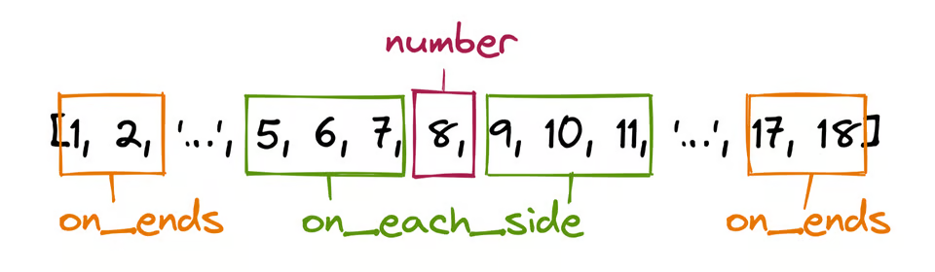
Paginator get_elided_page_range
Paginator.get_elided_page_range(number, *, on_each_side=3,
on_ends=2)
Returns a 1-based list of page numbers similar to Paginator.page_range, but may add an ellipsis to either or both sides of the current page number when Paginator.num_pages is large.
Image source: Pagination for a User-Friendly Django App – Real Python

Slide 27
Page Class
No need to construct it as it is generated from the Paginator
Methods
  Page.has_next() - Returns True if there’s a next page.
  Page.has_previous() - Returns True if there’s a previous page.
  Page.has_other_pages() - Returns True if there’s a next or previous page.
  Page.next_page_number() - Returns the next page number. Raises InvalidPage if next page doesn’t exist.
  Page.previous_page_number() - Returns the previous page number. Raises InvalidPage if previous page doesn’t exist.
  Page.start_index() - Returns the 1-based index of the first object on the page, relative to all of the objects in the paginator’s list.
  Page.end_index() - Returns the 1-based index of the last object on the page, relative to all of the objects in the paginator’s list. For example, when paginating a list of 5 objects with 2 objects per page, the second page’s end_index() would return 4.

Slide 28
Example View
def studentlist(request, page):
students = Student.objects.all().order_by("lastName")
paginator = Paginator(students, 20)
page_object = paginator.get_page(page)
page_object.adjusted_elided_pages = paginator.get_elided_page_range(page, on_each_side=1, on_ends=1)
context = {"page_obj": page_object}
return render(request, 'studentlist.html', context)

Slide 29
Example View … 1
def studentlist(request, page):
students = Student.objects.all().order_by("lastName")
paginator = Paginator(students, 20)
page_object = paginator.get_page(page)
page_object.adjusted_elided_pages = paginator.get_elided_page_range(page, on_each_side=1, on_ends=1)
context = {"page_obj": page_object}
return render(request, 'studentlist.html', context)
We have added a page parameter to the view – this means we will also have to update all of the urls that reference this view and the pattern in urls.py

Slide 30
Example View … 2
def studentlist(request, page):
students = Student.objects.all().order_by("lastName")
paginator = Paginator(students, 20)
page_object = paginator.get_page(page)
page_object.adjusted_elided_pages = paginator.get_elided_page_range(page, on_each_side=1, on_ends=1)
context = {"page_obj": page_object}
return render(request, 'studentlist.html', context)
We sorted our student object by last name

Slide 31
Example View … 3
def studentlist(request, page):
students = Student.objects.all().order_by("lastName")
paginator = Paginator(students, 20)
page_object = paginator.get_page(page)
page_object.adjusted_elided_pages = paginator.get_elided_page_range(page, on_each_side=1, on_ends=1)
context = {"page_obj": page_object}
return render(request, 'studentlist.html', context)
We are going to display 20 students on each page

Slide 32
Example View … 4
def studentlist(request, page):
students = Student.objects.all().order_by("lastName")
paginator = Paginator(students, 20)
page_object = paginator.get_page(page)
page_object.adjusted_elided_pages = paginator.get_elided_page_range(page, on_each_side=1, on_ends=1)
context = {"page_obj": page_object}
return render(request, 'studentlist.html', context)
We are going list the page numbers either side of the current page and show the first and last page number.

Slide 33
Example Template
{% extends "base.html" %}
{% block content %}
<h2>Students Enrolled</h2>
<table class="table table-striped table-hover">
<thead class="thead-dark">
<tr>
<th scope="col">ID</th>
<th scope="col">First Name</th>
<th scope="col">Last Name</th>
</tr>
</thead>
<tbody>
{% for student in page_obj %}
<tr>
<th scope="row"><a href="{% url 'myApp:student_detail' student.id %}">{{student.id}}</th>
<td>{{student.firstName|capfirst}}</td>
<td>{{student.lastName|upper}}</td>
</tr>
{% endfor %}
</tbody>
</table>
{% endblock %}

Slide 34
Example Template … 1
{% extends "base.html" %}
{% block content %}
<h2>Students Enrolled</h2>
<table class="table table-striped table-hover">
<thead class="thead-dark">
<tr>
<th scope="col">ID</th>
<th scope="col">First Name</th>
<th scope="col">Last Name</th>
</tr>
</thead>
<tbody>
{% for student in page_obj %}
<tr>
<th scope="row"><a href="{% url 'myApp:student_detail' student.id %}">{{student.id}}</th>
<td>{{student.firstName|capfirst}}</td>
<td>{{student.lastName|upper}}</td>
</tr>
{% endfor %}
</tbody>
</table>
{% endblock %}
We have passed the page object as the context here. We also want to add the pagination here – we can do this by adding an extra block to the base.html page and then implementing specific pagination in our template beneath the content block

Slide 35
Template Pagination Block
{% block pagination %}
<nav aria-label="Page navigation">
<ul class="pagination justify-content-center">
<!-- link to previous page-->
…
<!-- loop over elided pages linking to them -->
…
<!-- link to next page-->
…
</ul>
</nav>
<a>page {{page_obj.number}} of {{page_obj.paginator.num_pages}}</a>
{% endblock %}
Using pagination from bootstrap

Slide 36
Link to Previous
<!-- link to previous page-->
{% if page_obj.has_previous %}
<li class="page-item">
<a class="page-link"
href="{% url 'myApp:studentlist' page_obj.previous_page_number %}"
aria-label="Previous">
<span aria-hidden="true">&laquo;</span>
</a>
</li>
{% endif %}
Using passed through page_obj to check existence and show link if relevant. You could just mark it as disabled rather than not show it – see options in Bootstrap

Slide 37
Loop Over elided Pages
<!-- loop over elided pages linking to them -->
{% for page_number in page_obj.adjusted_elided_pages %}
{% if page_number == page_obj.paginator.ELLIPSIS %}
{{page_number}}
{% else %}
{% if page_obj.number == page_number %}
<li class="page-item active"> <a class="page-link"
href="{% url 'myApp:studentlist' page_number %}">{{page_number}}</a></li>
{% else %}
<li class="page-item"><a class="page-link"
href="{% url 'myApp:studentlist' page_number %}">{{page_number}}</a></li>
{% endif %}
{% endif %}
{% endfor %}

Slide 38
Link to Next
<!-- link to next page-->
{% if page_obj.has_next %}
<li class="page-item">
<a class="page-link"
href="{% url 'myApp:studentlist’ page_obj.next_page_number %}"
aria-label="Previous">
<span aria-hidden="true">&raquo;</span>
</a>
</li>
{% endif %}

Slide 39
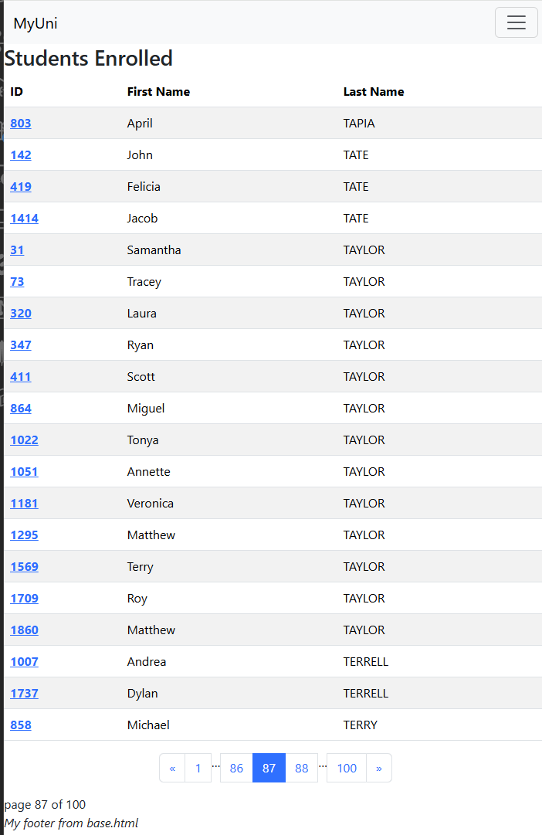
Result

